Slide 1

Microprocessors and Assembly Language Fall 2019
Hamed Farbeh
farbeh@aut.ac.ir
Department of Computer Engineering
Amirkabir University of Technology
Lecture 15

Slide 2
Copyright Notice
Parts (text & figures) of this lecture are adopted from:
Design of Microprocessor-Based Systems (aka Embedded Systems Design and Implementation), Prabal Dutta, University of Michigan
Cortex™-M3 Revision r2p1 Technical Reference Manual
ARMv7-M Architecture Reference Manual
Atmel | SMART ARM-based MCU DATASHEET, SAM3X / SAM3A Series, Atmel-11057C-ATARM-SAM3X-SAM3A-Datasheet_23-Mar-15
Microprocessors and Assembly Language, Fall 2019, AUT, Tehran, Iran

Slide 3
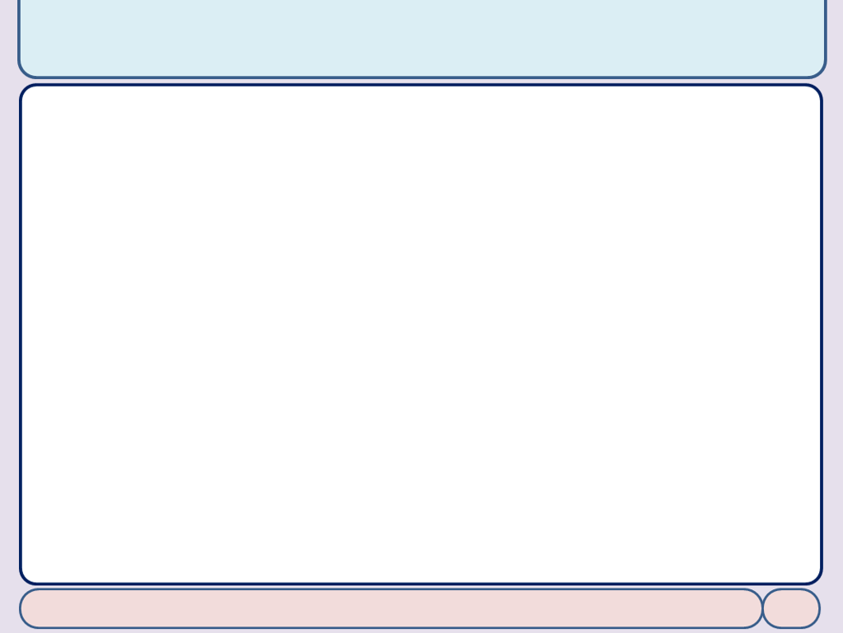
Parallel Input/Output Controller (PIO)
Microprocessors and Assembly Language, Fall 2019, AUT, Tehran, Iran

Slide 4
PIO Description
Parallel Input/Output Controller (PIO)
manages up to 32 fully programmable input/output lines
Each I/O line may be dedicated as a general-purpose I/O or be assigned to a function of an embedded peripheral
Each I/O line of the PIO Controller features
An input change interrupt enabling level change detection on any I/O line.
Additional Interrupt modes enabling rising edge, falling edge, low level or high level detection on any I/O line.
A glitch filter providing rejection of glitches lower than one-half of system clock cycle
A debouncing filter providing rejection of unwanted pulses from key or push button operations
Multi-drive capability similar to an open drain I/O line
Control of the pull-up of the I/O line
Input visibility and output control
A synchronous output providing up to 32 bits of data output in a single write operation
Chapter 31: Atmel | SMART ARM-based MCU DATASHEET, SAM3X / SAM3A Series, Atmel-11057C-ATARM-SAM3X-SAM3A-Datasheet_23-Mar-15
Microprocessors and Assembly Language, Fall 2019, AUT, Tehran, Iran

Slide 5
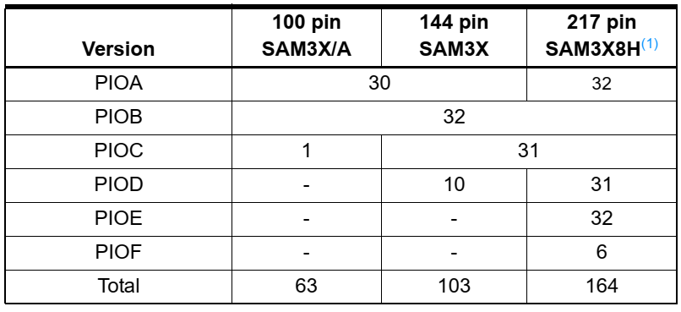
PIO Description
Parallel Input/Output Controller (PIO)
Each PIO Controller controls up to 32 programmable I/O Lines
Chapter 31: Atmel | SMART ARM-based MCU DATASHEET, SAM3X / SAM3A Series, Atmel-11057C-ATARM-SAM3X-SAM3A-Datasheet_23-Mar-15
Microprocessors and Assembly Language, Fall 2019, AUT, Tehran, Iran

Slide 6
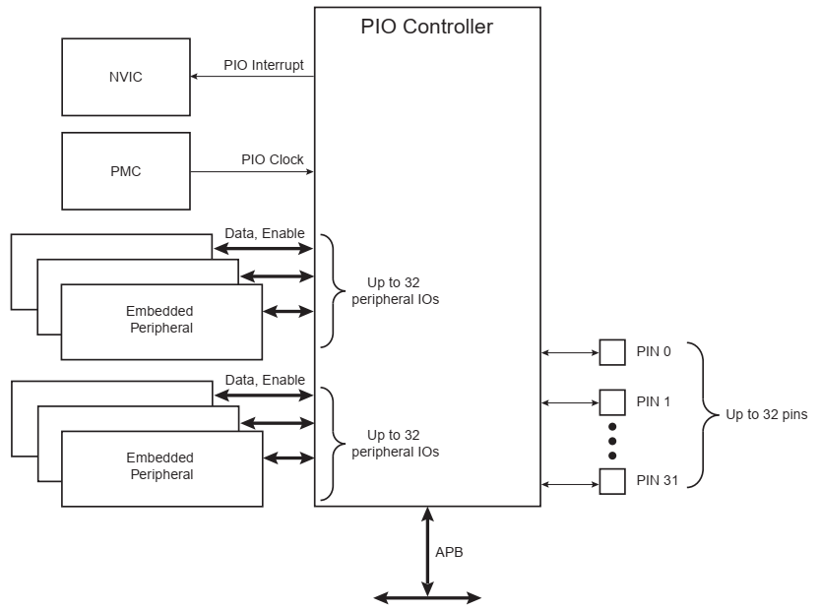
PIO Block Diagram
Chapter 31: Atmel | SMART ARM-based MCU DATASHEET, SAM3X / SAM3A Series, Atmel-11057C-ATARM-SAM3X-SAM3A-Datasheet_23-Mar-15
Microprocessors and Assembly Language, Fall 2019, AUT, Tehran, Iran

Slide 7
Product Dependencies
Pin Multiplexing
Each pin is configurable, according to product definition
A general-purpose I/O line only
An I/O line multiplexed with one or two peripheral I/Os
Power Management
Controls the PIO Controller clock in order to save power
Writing any of the registers of the user interface does not require the PIO Controller clock to be enabled
Not all of the features of the PIO Controller are available when the clock is disabled
Input Change Interrupt, Interrupt Modes on a programmable event and the read of the pin level require the clock to be validated
After a hardware reset, the PIO clock is disabled by default
The user must configure the Power Management Controller before any access to the input line information
Chapter 31: Atmel | SMART ARM-based MCU DATASHEET, SAM3X / SAM3A Series, Atmel-11057C-ATARM-SAM3X-SAM3A-Datasheet_23-Mar-15
Microprocessors and Assembly Language, Fall 2019, AUT, Tehran, Iran

Slide 8
Product Dependencies
Interrupt Generation
The PIO Controller is connected on one of the sources of the NVIC
Using the PIO Controller requires the NVIC to be programmed first
The PIO Controller interrupt can be generated only if the PIO Controller clock is enabled
Chapter 31: Atmel | SMART ARM-based MCU DATASHEET, SAM3X / SAM3A Series, Atmel-11057C-ATARM-SAM3X-SAM3A-Datasheet_23-Mar-15
Microprocessors and Assembly Language, Fall 2019, AUT, Tehran, Iran

Slide 9
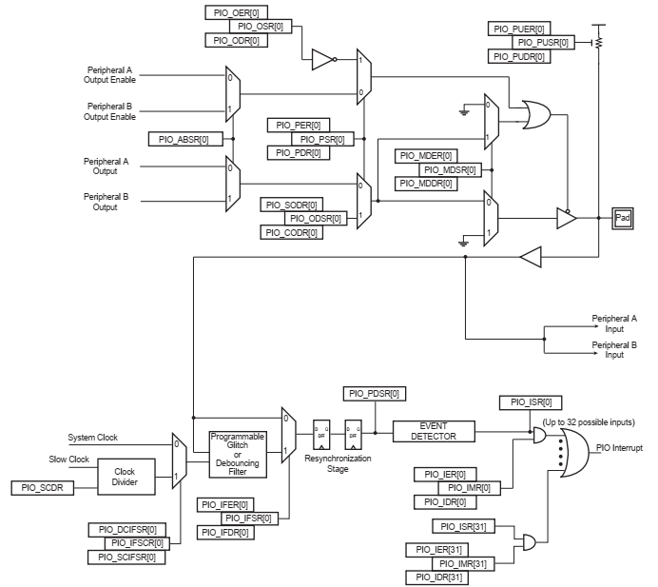
Functional Description
Chapter 31: Atmel | SMART ARM-based MCU DATASHEET, SAM3X / SAM3A Series, Atmel-11057C-ATARM-SAM3X-SAM3A-Datasheet_23-Mar-15
Microprocessors and Assembly Language, Fall 2019, AUT, Tehran, Iran

Slide 10
Functional Description
Pull-up Resistor Control
PIO_PUER: Pull-up Resistor Control
PIO_PUSR: Pull-up Status Register
After reset, all of the pull-ups are enabled, i.e. PIO_PUSR resets at the value 0x0
I/O Line or Peripheral Function Selection
PIO_PER: PIO Enable Register
PIO_PDR: PIO Disable Register
PIO_PSR: PIO Status Register
indicates whether the pin is controlled by the corresponding peripheral or by the PIO Controller, if 0:
pin is controlled by the corresponding on-chip peripheral selected in the PIO_ABSR (AB Select Register)
Chapter 31: Atmel | SMART ARM-based MCU DATASHEET, SAM3X / SAM3A Series, Atmel-11057C-ATARM-SAM3X-SAM3A-Datasheet_23-Mar-15
Microprocessors and Assembly Language, Fall 2019, AUT, Tehran, Iran

Slide 11
Functional Description
Output Control
PIO_OER: Output Enable Register
PIO_ODR: Output Disable Register
PIO_OSR: Output Status Register
When a bit in this register is at 0, the corresponding I/O line is used as an input only
When the bit is at 1, the corresponding I/O line is driven by the PIO controller
PIO_SODR: Set Output Data Register
PIO_CODR: Clear Output Data Register
PIO_ODSR: Output Data Status Register
Chapter 31: Atmel | SMART ARM-based MCU DATASHEET, SAM3X / SAM3A Series, Atmel-11057C-ATARM-SAM3X-SAM3A-Datasheet_23-Mar-15
Microprocessors and Assembly Language, Fall 2019, AUT, Tehran, Iran

Slide 12
Functional Description
Synchronous Data Output
Simultaneous write into PIO_SODR and PIO_CODR is not possible
PIO Controller offers a direct control of PIO outputs by single write access to PIO_ODSR
Multi Drive Control (Open Drain)
Permits several drivers to be connected on the I/O line which is driven low only by each device
PIO_MDER: Multi-driver Enable Register
PIO_MDSR: indicates the pins that are configured to support external drivers
After reset, the Multi Drive feature is disabled on all pins (PIO_MDSR = 0)
Chapter 31: Atmel | SMART ARM-based MCU DATASHEET, SAM3X / SAM3A Series, Atmel-11057C-ATARM-SAM3X-SAM3A-Datasheet_23-Mar-15
Microprocessors and Assembly Language, Fall 2019, AUT, Tehran, Iran

Slide 13
The End (for now)!
Microprocessors and Assembly Language, Fall 2019, AUT, Tehran, Iran

